Slide 1
Environment Pollution
Definition of environment Pollution, Causes, Types, Effect and Solution.
Taslima Akter
Department of Bangla1
SO 04-22
1

Slide 2
Environment Pollution
Pollution has become the first enemy of the mankind. Which brings about changes that affect our normal lifestyles everyday. when harmful substances contaminate the environment it is called pollution. And environment pollution refers to the harmful materials into the environment. In other words, environment pollution is the contamination of the environment to such an exptent that normal environmental processes are adversely affected.
Basically environment pollution can be defined any undesirable change in physical, chemical or biological characteristics of any component of the environment i.e. air ,water, soil which can cause harmful effects on various forms of life or property. That is happening in multifold parts of earth usually in the form of air and water pollution that make an environment unhealthy to live in.
2

Slide 3
Causes of Environment Pollution
Industries: Pollution by industries mainly causes air pollution, soil and water contamination can occur. This is particularly the case for power generating industries, such as plants producing electricity.
Transportation: As the traffic is increasing every day, pollution follows that evolution.
Agricultural Activities: Agriculture is mainly responsible for the contamination of water and soil. This is a caused by the increased use of pesticides, as well as by the intensive character if its production.
Smoke
Fertilizers
Population explosion
Trading activities etc.
3

Slide 4
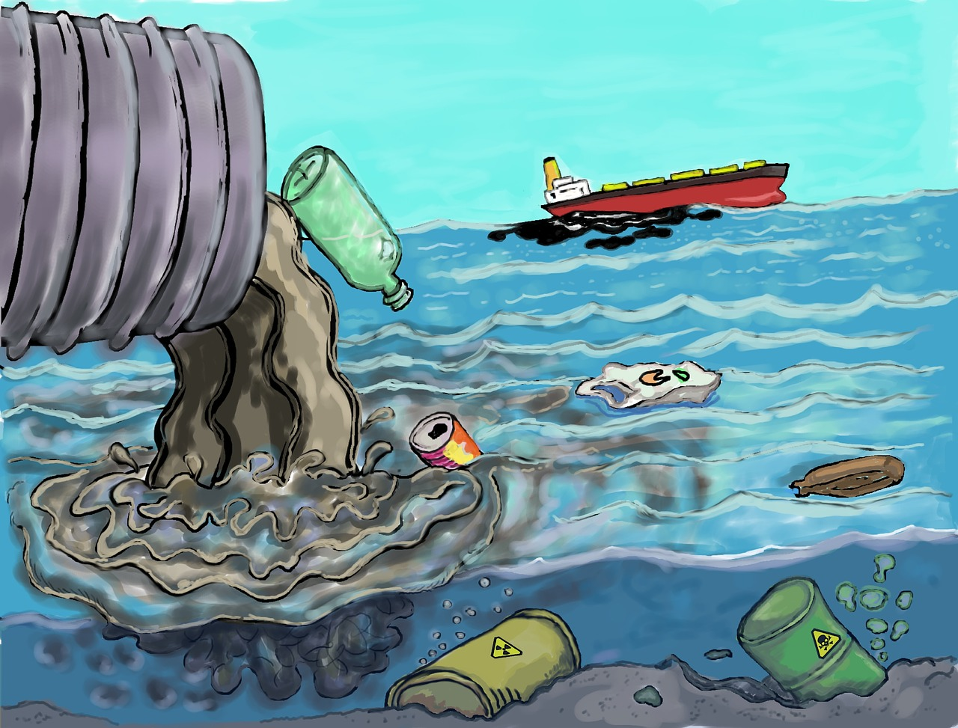
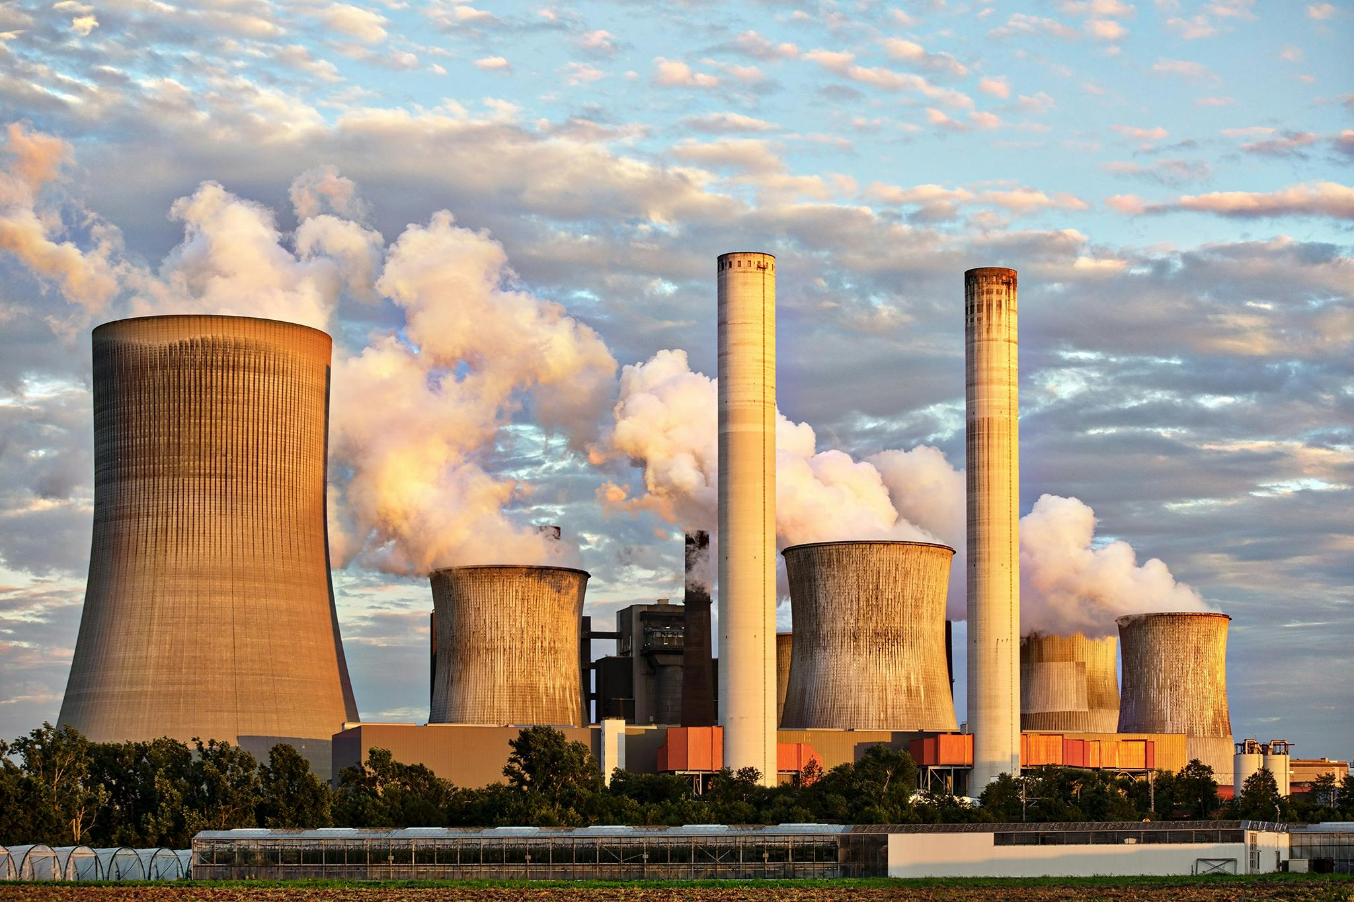
Types of Environment Pollution
Environment pollution is the introduction of harmful elements into the environment, which can damage ecosystems and human societies. Some types of environmental pollution include-
Air pollution: Vehicle emissions, industrial activities, burning fossil fuels, wildfires and more.
Water pollution: Caused by industrial wastes, oil spills, plastic wasre and effluents discharged into rivers.
Soil pollution: Use of pesticides, deforestation, landfills.
Noise pollution: Traffic, factories, construction activities. Unwanted sound that can cause hearing loss, high blood pressure and other health issues.
Land pollution: A significant issue that affects one-fourth of the Earth’s surface.
4
4

Slide 5
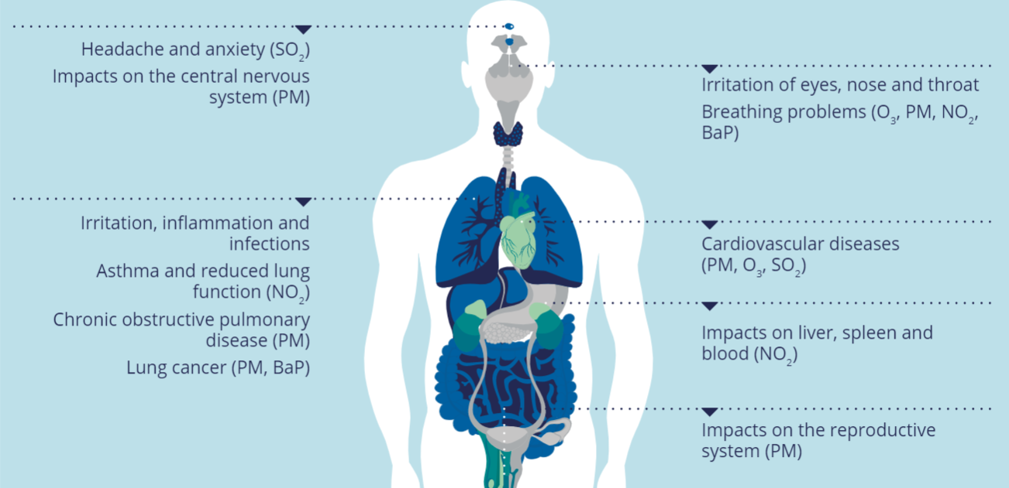
Effect of Environment Pollution
Health Issues: Respiratory problems, heart diseases, and cancer.
Environmental Impact: Climate change and global warming, Loss of biodiversity.
Economic Costs: Healthcare costs, damage to crops and property.
Effect on Animal: Acid rains can change the composition of rivers and seas, making them toxic for fishes, an important quqntity of ozone in the lower parts of the atmosphere can cause lung problems to all animals.
Effect on plants: As for animals, plants and especially tress can be destroyed by the acid rains, ozone in the lower atmosphere block the plant respiration and harmful pollutions can be absorbed from the water or soil.
5

Slide 6
Solutions to Environmental Pollution
Reduce, Reuse, Recycle: Minimize waste is one of the solutions to reduce environmental pollution.
Clean Energy: Promote solar, wind, and hydropower.
Public Awareness: Campaigns to educate people.
Government Policies: Stricter environmental laws and regulations.
6

Slide 7
Thank You
7

